Slide 1


Slide 2


Slide 3
Joel Kauffman
@ifranto
Vistacomm

Slide 4
Why do I need an API?
What do I need from an API?
What framework should I use?

Slide 5
Why do I need an API?

Slide 6
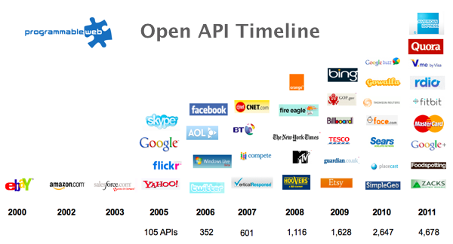

Slide 7
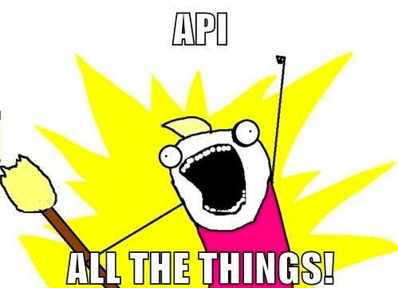

Slide 8
What do I want from an API?

Slide 9


Slide 10


Slide 11


Slide 12


Slide 13
What framework should I use?

Slide 14


Slide 15


Slide 16


Slide 17


Slide 18

ASP.NET Web API

Slide 19
Microsoft
@howard_dierking
http://www.asp.net/web-api

Slide 20
 | WebAPI
Ease of use | Good
Documented | MSDN
Documentation | Yes
OData | Yes
Customization | Good
Hosting | IIS, Self

Slide 21


Slide 22
@thecodejunkie (Andreas Håkansson)
@grumpydev (Steven Robbins)
http://nancyfx.org

Slide 23
 | WebAPI | Nancy
Ease of use | Good | Good
Documented | MSDN | Yes
Documentation | Yes | No
OData | Yes | Yes
Customization | Good | Good
Hosting | IIS, Self | IIS, Self, OWIN, Mono

Slide 24


Slide 25
@demisbellot
http://www.servicestack.net

Slide 26
 | WebAPI | Nancy | ServiceStack
Ease of use | Good | Good | Good
Documented | MSDN | Yes | Yes
Documentation | Yes | No | Yes
OData | Yes | Yes | No
Customization | Good | Good | Great
Hosting | IIS, Self | IIS, Self, OWIN, Mono | IIS, Self, Mono

Slide 27


Slide 28
@serialseb (Sebastien Lambla)
http://openrasta.org

Slide 29
 | WebAPI | Nancy | ServiceStack | OpenRasta
Ease of use | Good | Good | Good | Poor
Documented | MSDN | Yes | Yes | Yes
Documentation | Yes | No | Yes | No
OData | Yes | Yes | No | No
Customization | Good | Good | Great | You will
Hosting | IIS, Self | IIS, Self, OWIN, Mono | IIS, Self, Mono | IIS

Slide 30
Simple.Web

Slide 31
@markrendle
https://github.com/markrendle/Simple.Web

Slide 32
 | WebAPI | Nancy | OpenRasta | ServiceStack | Simple.Web
Ease of use | Good | Good | Good | Poor | Poor
Documented | MSDN | Yes | Yes | Yes | No
Documentation | Yes | No | Yes | No | No
OData | Yes | Yes | No | No | No
Customization | Good | Good | Great | You will | Ruby
Hosting | IIS, Self | IIS, Self, OWIN, Mono | IIS, Self, Mono | IIS | IIS, Mono

Slide 33
Joel Kauffman
@ifranto
kauffmanjk@gmail.com
github.com/ifranto/apidemo

